Slide 1
EVOLUTION OF HORSE

Slide 2
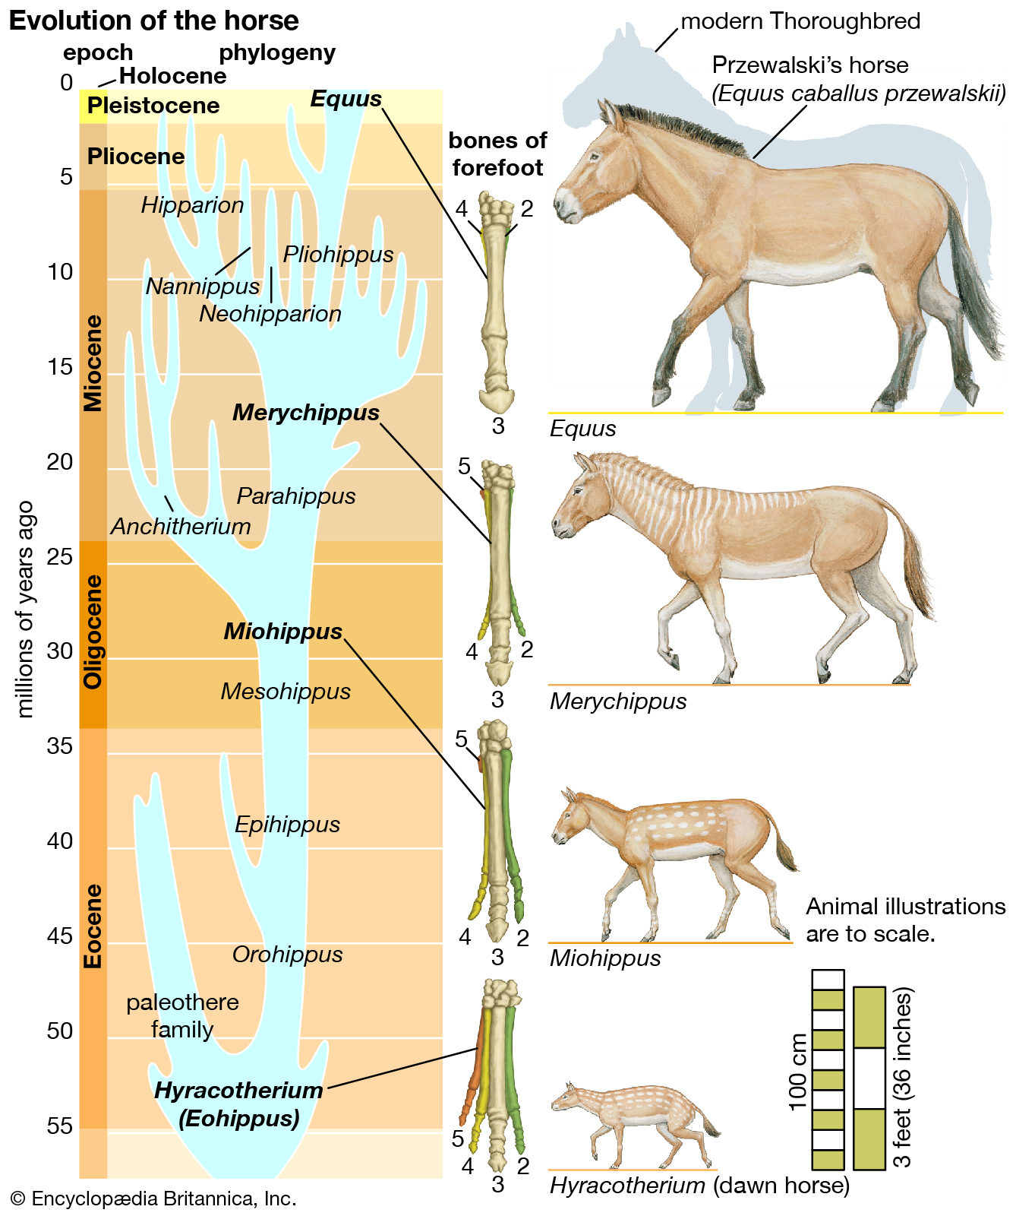

Slide 3
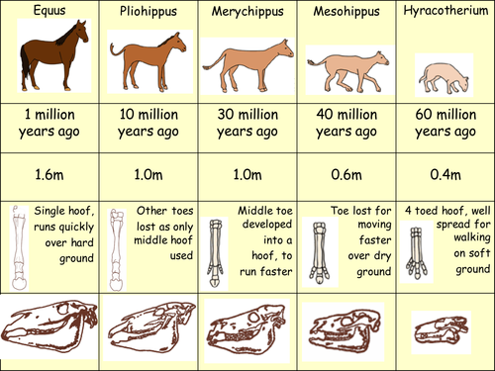

Slide 4
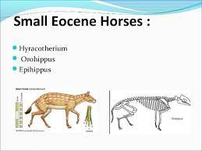

Slide 5
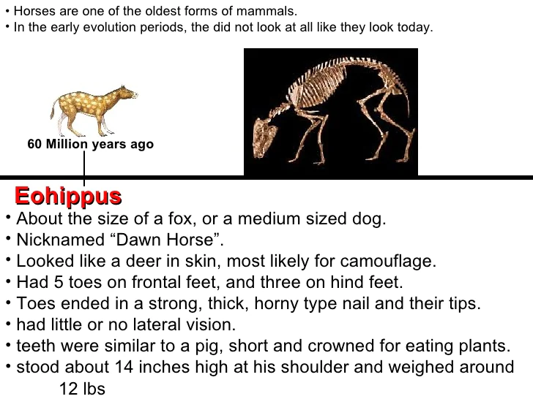

Slide 6
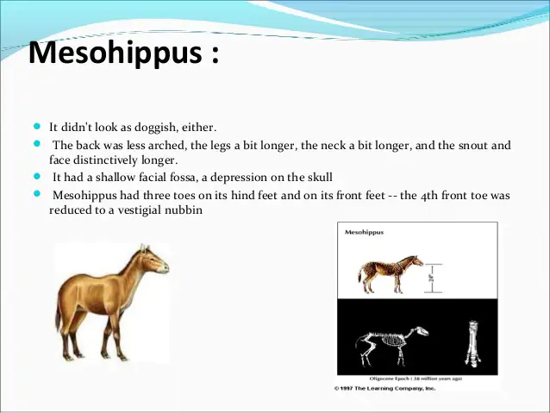
OLIGOCENE HORSES

Slide 7
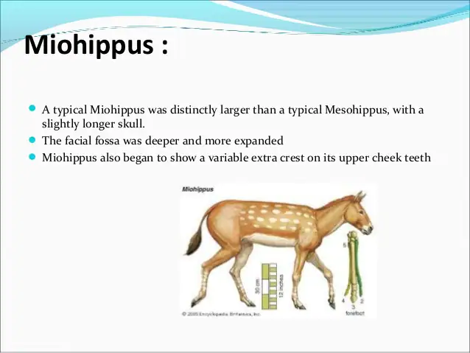

Slide 8

MIOCENE HORSES
Anchitherium
Hypohippus
Parahippus
Merychippus

Slide 9
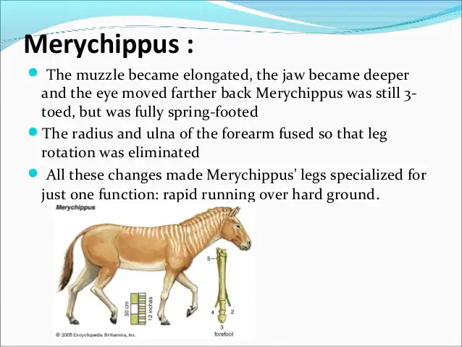

Slide 10
PLIOCENE HORSES
Hipparion
Neohipparion and Nanippus
Pliohippus
Dinohippus
Plesippus

Slide 11
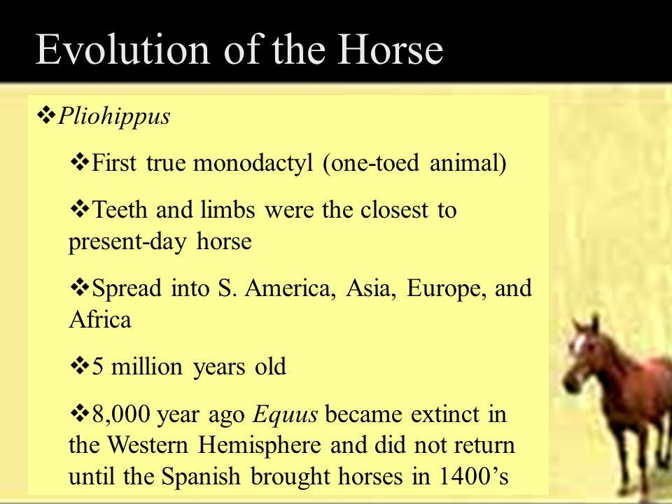

Slide 12
PLEISTOCENE HORSES
EQUUS
The first equus as about 60 inches tall, rigid spine, long legs, fused leg bones with no rotation
The brain as a bit larger than in Dinohippus
This species has straight grazing teeth with strong crests lined with cement.
It has lost first and fifth digits
The weight of the body is balanced by the third toe only.
Legs are quite long and brain well developed
S wift running and feeding on all sorts of grasses

