Slide 1
ECOLOGICAL SUCCESSION AND BIOGEOCHEMICAL CYCLE
DR SHARMISTHA CHAKRAVARTY
DEPT OF ZOOLOGY
BARNAGAR COLLEGE SORBHOG

Slide 2
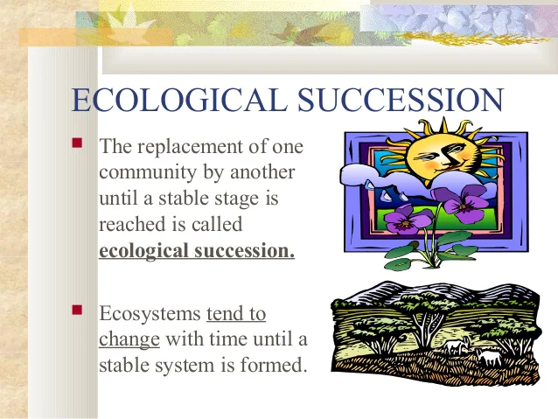

Slide 3
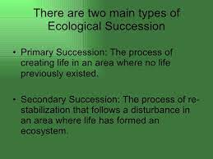

Slide 4
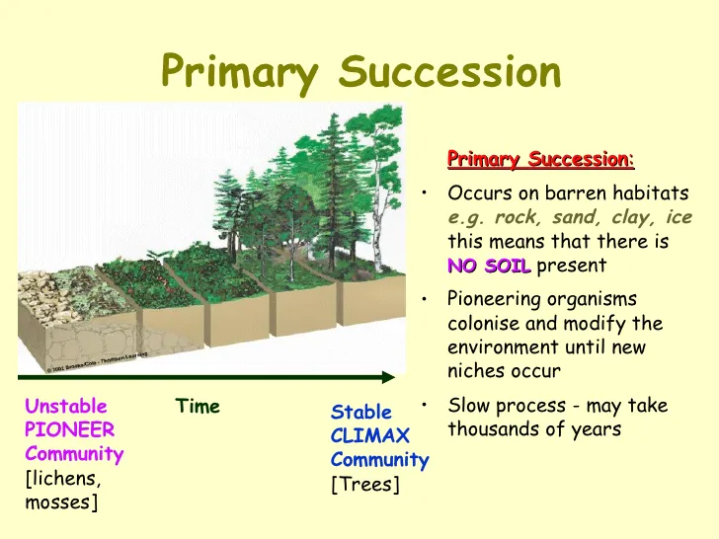

Slide 5
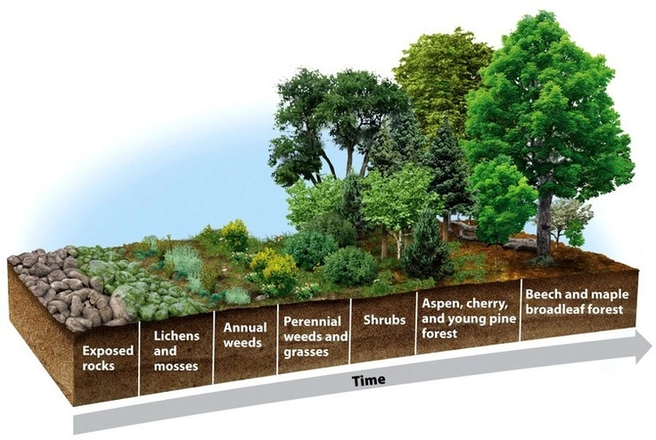
XERACH SUCCESSION

Slide 6
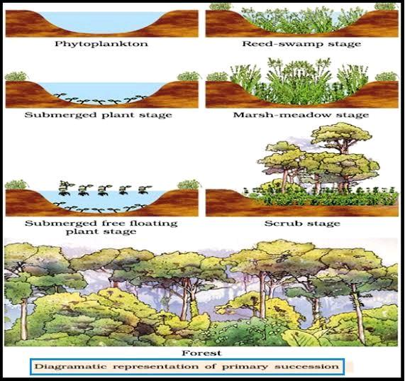
HYDRACH SUCCESSION

Slide 7
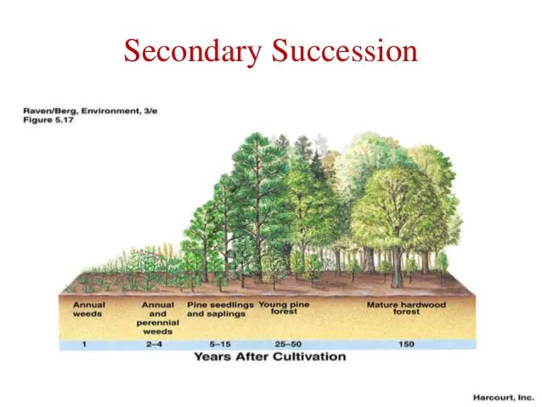

Slide 8
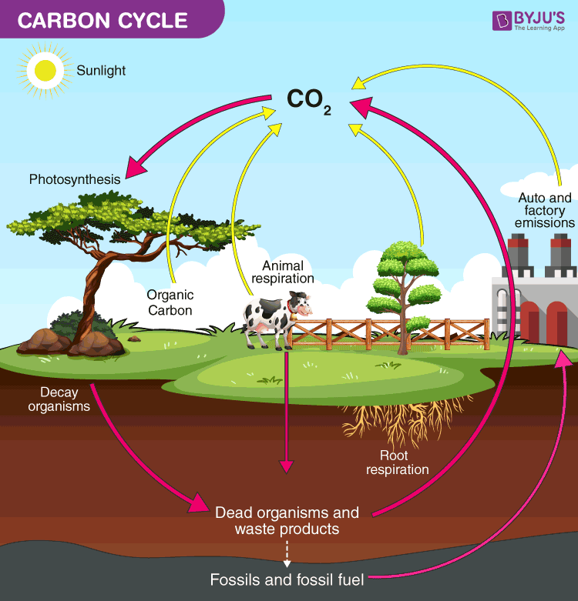

Slide 9
